Slide 1
Core Genesis Project
Theory III
Developed by Zak “Lord Cyclohexane” Gillman
Compiled by Matt “Strahdsbuddy” Doyle
This version of the Core Genesis project looks at the theories put forth by Lord Cyclohexane, in particular the revolutionary idea that the Core itself may not have formed until much later than what is usually accepted in canon. The beginning of the timeline cleaves to canon, but in slide 11 separate clusters form, defining this theory. Enjoy!

Slide 2
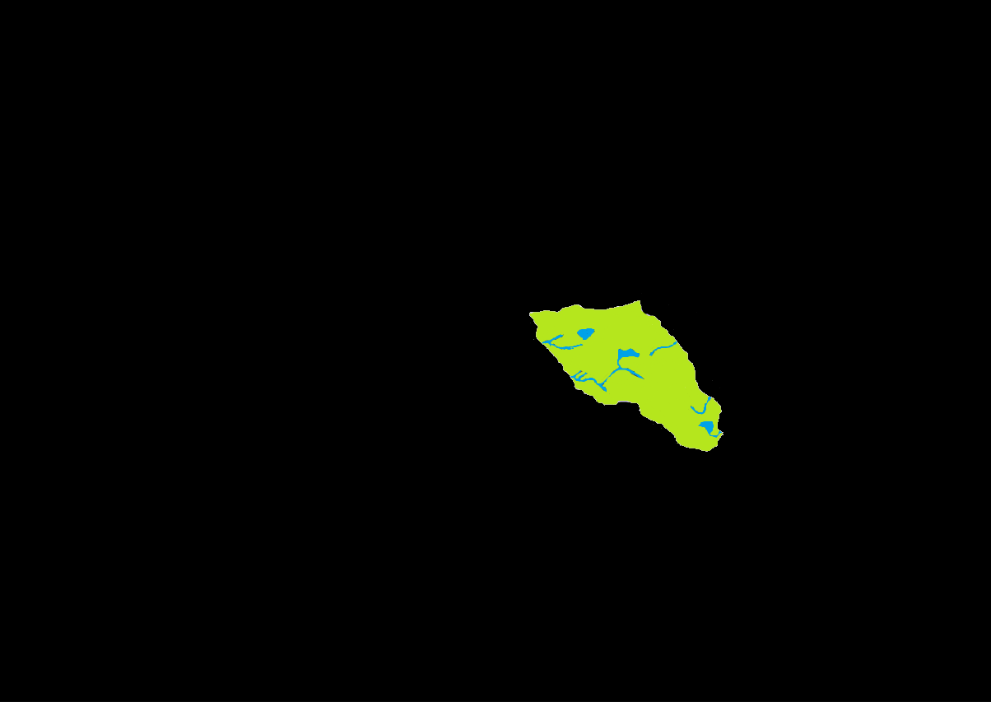
351 BC: A Lonely Island
Notes:
Every timeline’s starting point is the formation of Barovia in 351. That Barovia existed for centuries as an island isolated in the Mists is not disputed. The events of I:6 can be assumed to take place during this time period, although the 2E update and 4E updates probably fall later on the timeline, depending on DM preference.

Slide 3
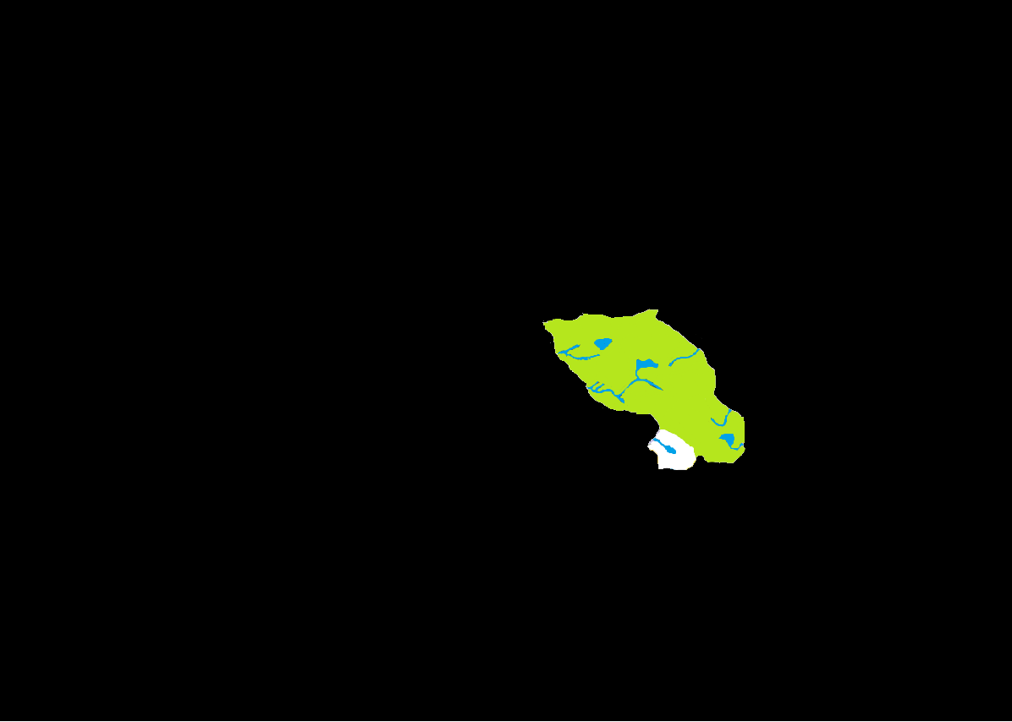
547 BC: The First Cluster
Notes:
The 1st Barovian Cluster forms when Forlorn attaches itself on the southern border. Strahd found this land to be a curiosity, and after an initial search through magical means, largely ignored his neighbor. Enterprising Barovians may have tried exploring the strange realm, though such expeditions most likely resulted in disaster. Forlorn’s goblyns most likely stayed on their side of the border, intent on carrying out the task their master had set forth for them.

Slide 4
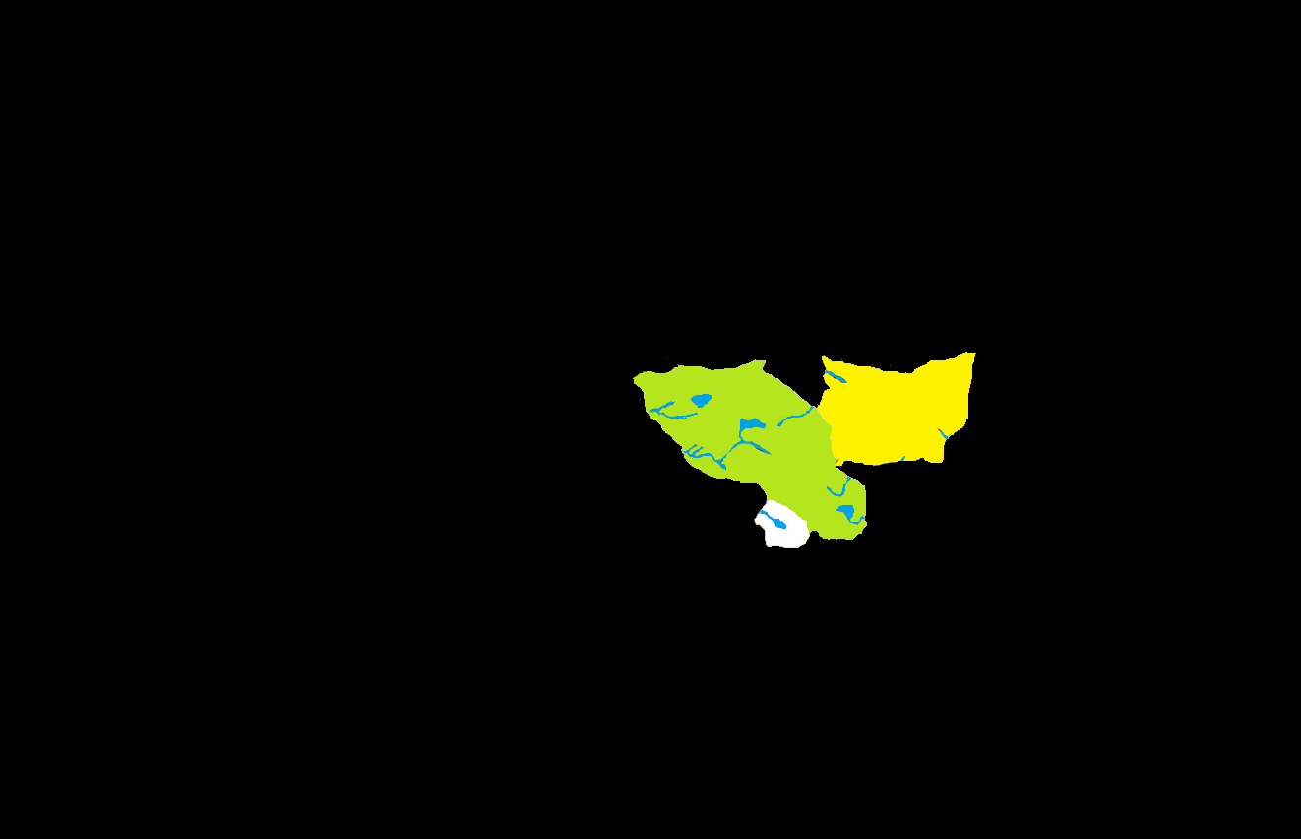
575 BC: The Fey
Notes:
Barovia and Forlorn were drawn from worlds where magic was somewhat commonplace, but the appearance of Arak is probably their first encounter with anything as foreign as the race of fey that came with it. Fearing the sunlight, the fey were ravenous tunnelers and may have begun expanding into neighboring lands almost immediately (or sooner, due to the temporal fugue). The human population of Arak is mentioned only in passing, and they most likely were absorbed by Barovia in the span of a few generations.

Slide 5
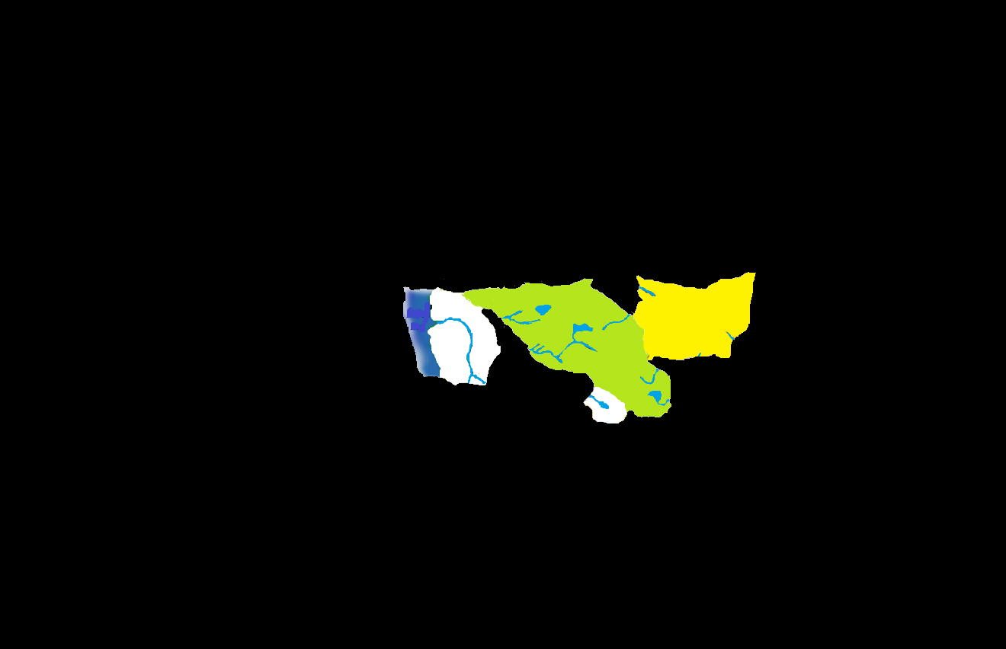
579 BC (Autumn): The Failed Escape
Notes:
During the events of I:10, Azalin helps Strahd break the bonds of darklordship, albeit briefly. Their sojourn to Mordent resulted in the tragic inclusion of that land in the demiplane. Although close in proximity, Krezk and Mordentshire were probably not fast trading partners. Language difficulties and the insular nature of the Barovians would have most likely forced the Mordentmen to look to their old ally, the sea, for their livelihood.

Slide 6
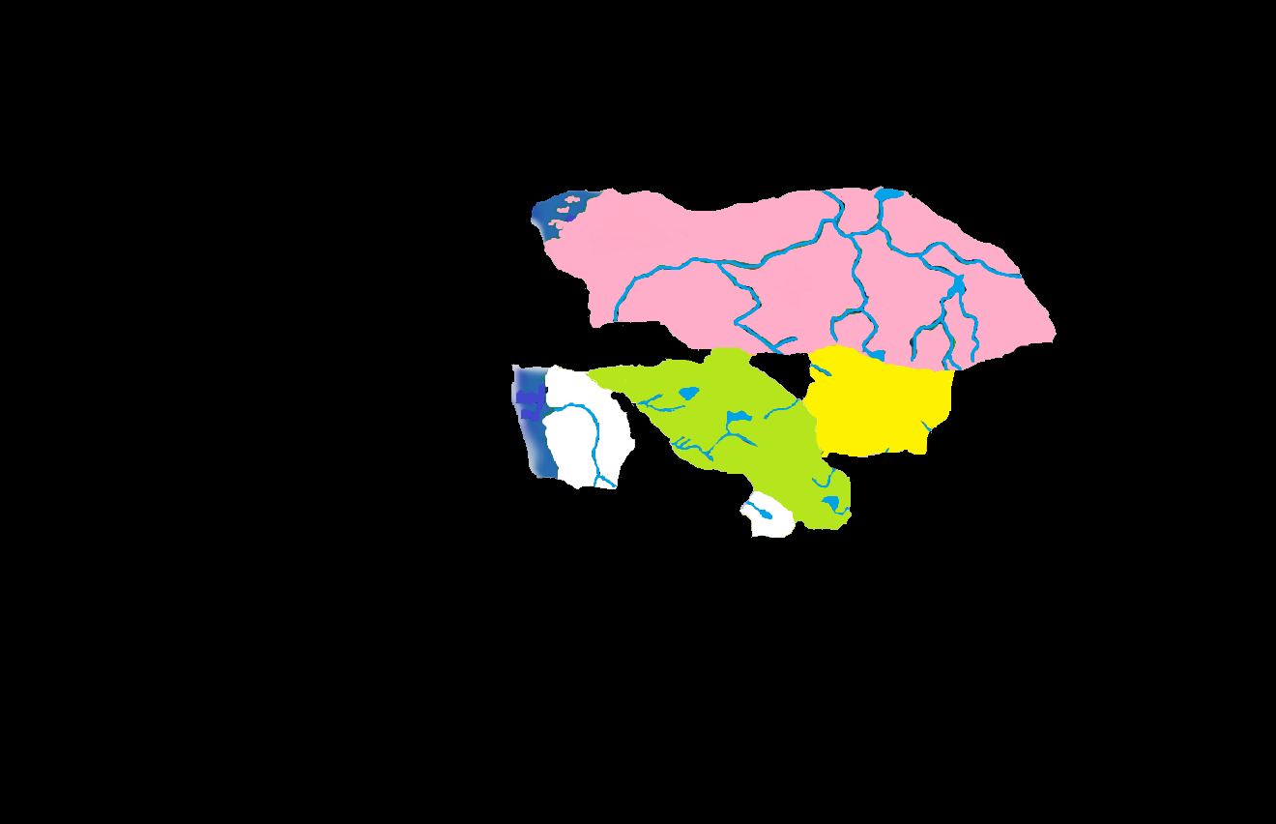
579 BC (Winter): The Great Neighbor
Notes:
Although Martira Bay is said to have had a tiny population at the time of Darkon’s formation, the amount of human beings in the Land of Mists must have at least quintupled with the new domain’s arrival. Again, Barovians would have probably not been terribly welcoming to any Darkonian merchants, and few roads existed between the realms anyway. Darkon did not really need a trading partner, although Mordentish captains had a knack for finding their way through misty waters on the trade route between Mordentshire and Martira Bay.

Slide 7
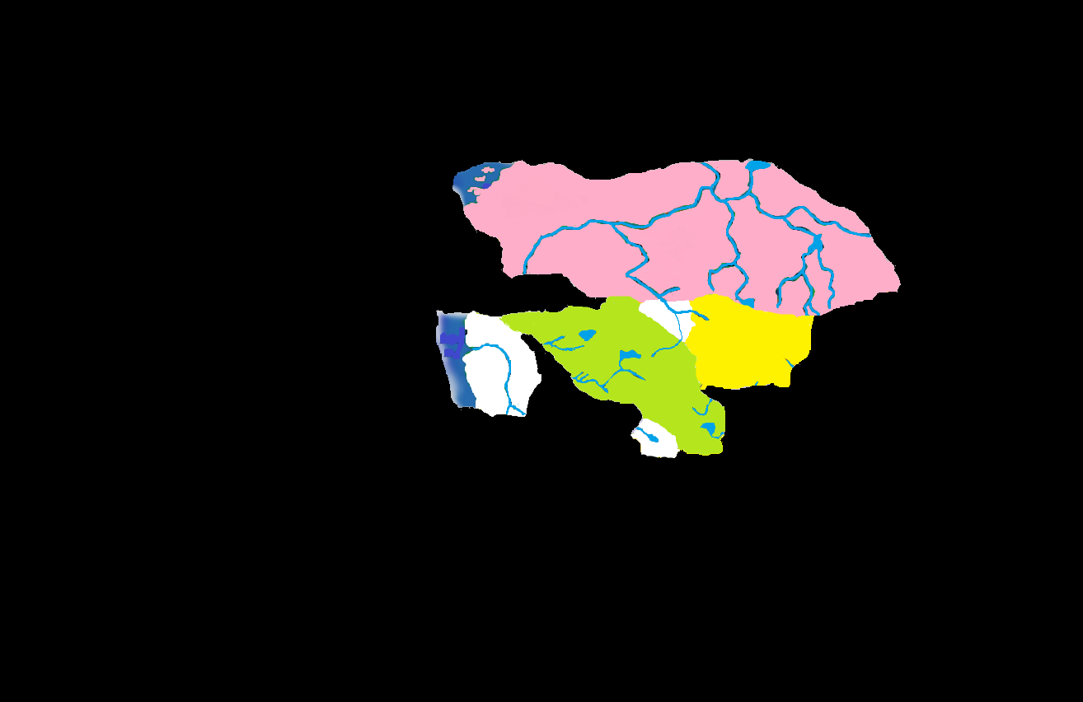
588 BC: Mount Lament
Notes:
The execution of Tristessa resulted in the new domain of Keening. Keening filled a little gap between Barovia, Darkon and Arak, which may have actually belonged to an unnamed domain prior to Keening. The city of the dead at the base of Mt. Lament does not bear a resemblance to any of Barovian or Darkonian make, and the language written on books recovered from there is altogether unique.
An important omission from this version of the timeline is Bluetspur. While there can be no debate of its date of formation (according to canon) this does not necessarily mean that it immediately took its place alongside Barovia. Logic says it did not, since the existence of so many creatures that fed on human beings would have most likely overrun the southern half of the cluster in a decade. Many have said that Bluetspur is Ravenloft’s moon, and that may well be where it exists at this point in time. Consider it an Island of Terror for the time being.

Slide 8
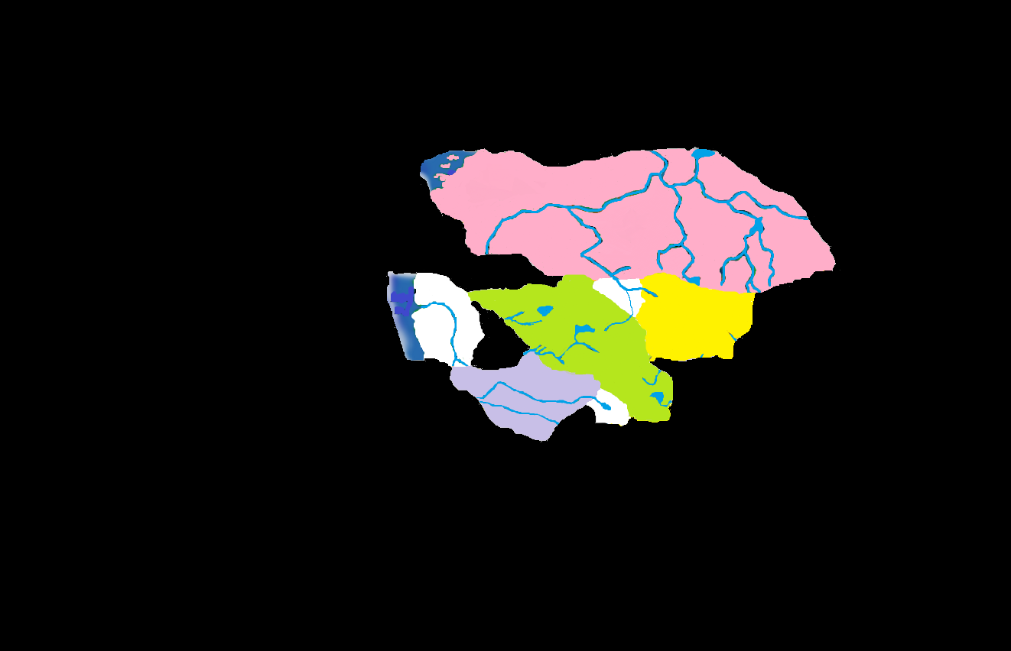
593 BC: Gundar
Notes:
Though reports say Gundar emerged from the Mists near Krezk, Berez is a more likely option due to its proximity to the Gundardak border. Contact with Mordent was probably minimal, so once Strahd and Gundar stopped trying to blatantly kill each other, the Gundarakites probably settled into a healthy trade relationship with their Barovian neighbors. Little is known about Gundarak during this period; most of the action here begins in about 125 years.

Slide 9
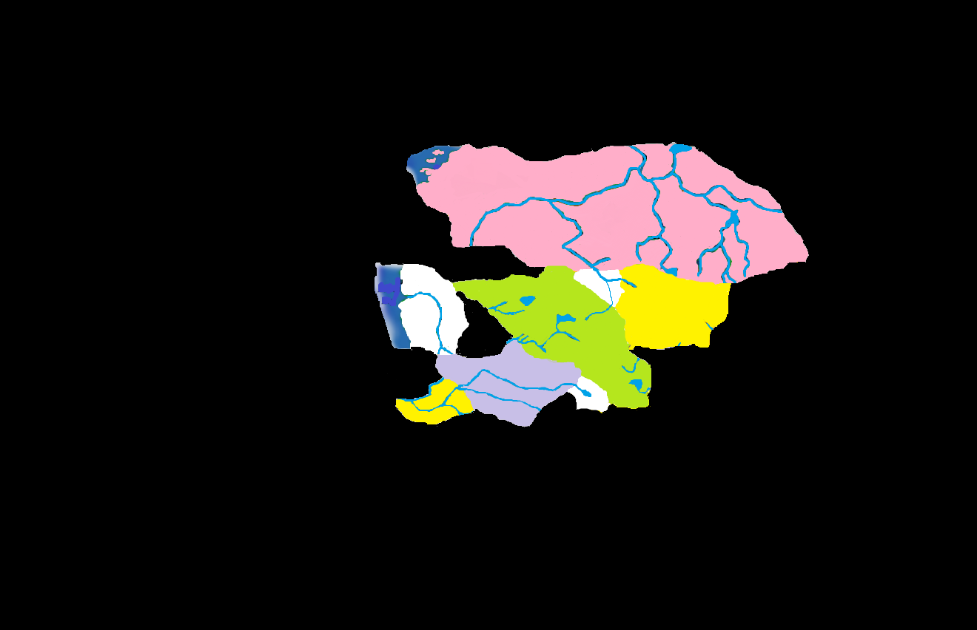
603 BC: Bakholis Defiant
Notes:
The original lord of Invidia is described as a cursed werewolf. It is not known if he was already in the Land of Mists or if he had been drawn from another realm. This isolated nation exists on the rump of Gundarak for a century, remaining fiercely independent of the larger and stronger nation.

Slide 10
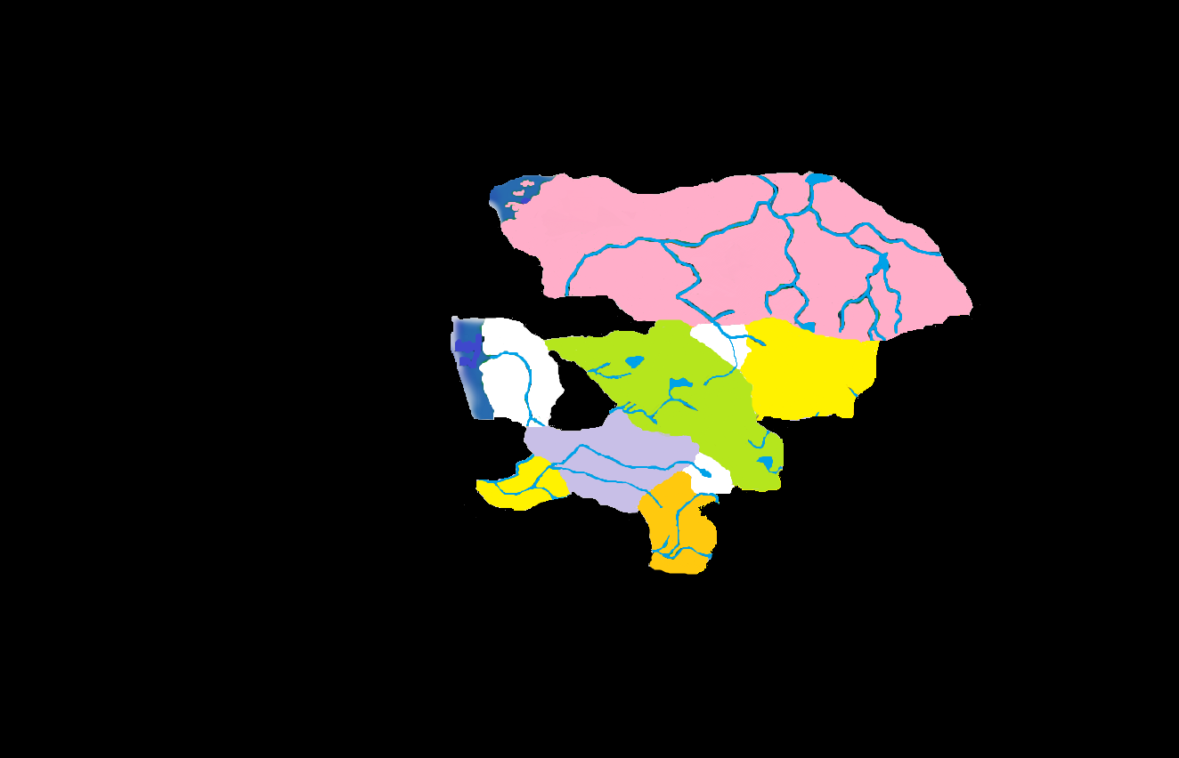
613 BC: Another Kind of Wolf
Notes:
Harkon Lukas had been in the demiplane for three years before his domain of Kartakass formed. Strahd and Gundar may have teamed up to trap him in his own domain in a way similar to the way they dealt with Soth a century later. Gundarak now had two neighbors to itself (Forlorn was not known for its diplomacy) and attempted more than once to exploit Kartakan forests and resources. While no formal war ever erupted, Gundarakite expeditions were known to fall victim to a suspiciously high number of predators.

Slide 11
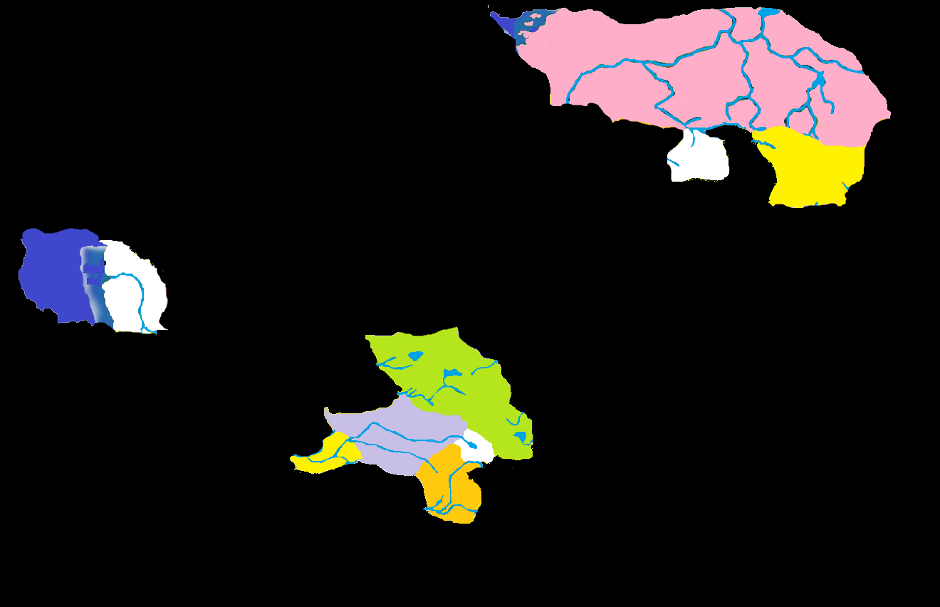
625 BC: The Split
Notes:
No evidence exists to place the dramatic sundering of the 1st Barovian Cluster in this year, but certain assumptions may lead to the reader’s understanding of its reasoning. 625 is the same year of the creation of the domain of Valachan, a realm made for an ex-Kargat vampire, Urik von Karkhov. Although it is never mentioned in his back story, von Karkhov may have been a pawn in one of Azalin’s powerful schemes and his reward for assisting was Valachan (which exists as an Island of Terror). Azalin’s plot probably had to do with the fey, since the two fey nations of Arak and Keening were torn apart. What this plan may have been is up for discussion.
The important reality is that this had to happen before 682, and it makes sense that these three clusters began growing on their own until something made them congeal again into a single landmass. Darkon, Keening and Arak form the Darkonian Cluster. Barovia, Forlorn, Gundarak, Invidia, and Kartakass form the 2nd Barovian Cluster. Mordent is currently on its own, although in 630 the unchartable Sea of Sorrows off its coast becomes its own domain. Several islands, such as Graben, join this cluster intermittently, but since they cannot be effectively mapped they are omitted.

Slide 12
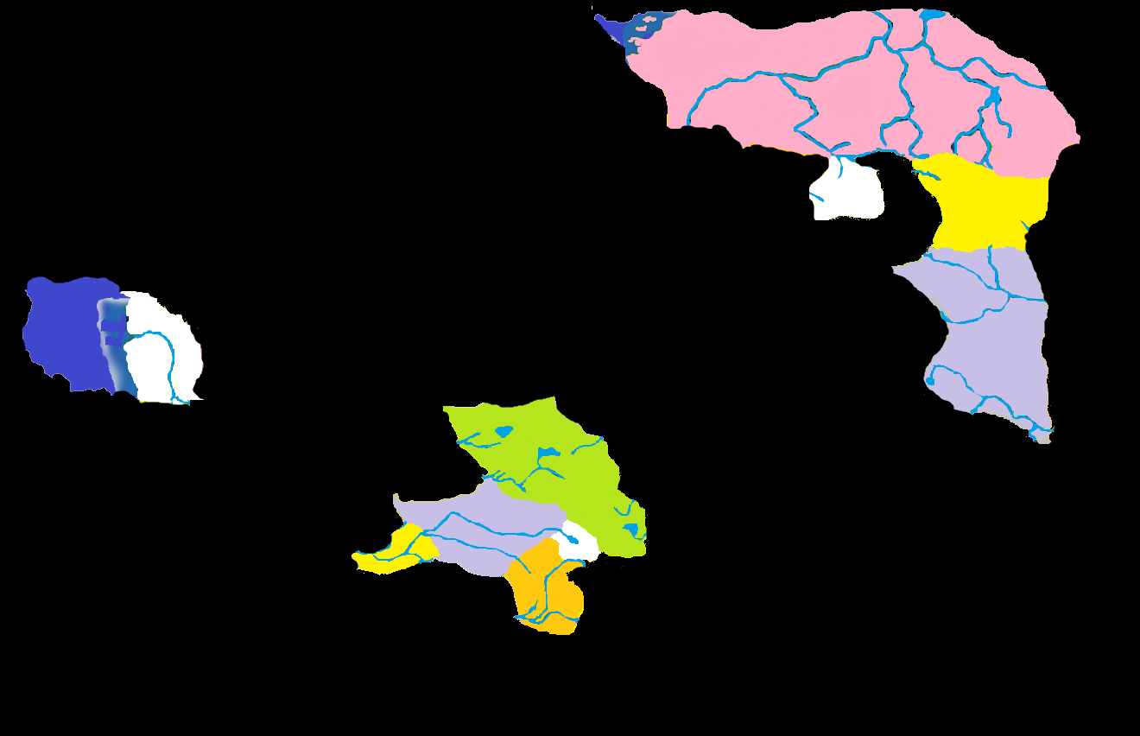
682 BC: Vaasi Arrival
Notes:
Fifty-Seven years after the Split, the first domain sprouts from one of the new clusters: Nova Vaasa. With barren Arak between them, contact between Darkon and Nova Vaasa was probably minimal. During this time period, the Vistani were probably the most effective form of trade and travel, and their reputation for treachery may spring from the influence they wielded in a time when populations were so spread out and unreachable by conventional means.

Slide 13
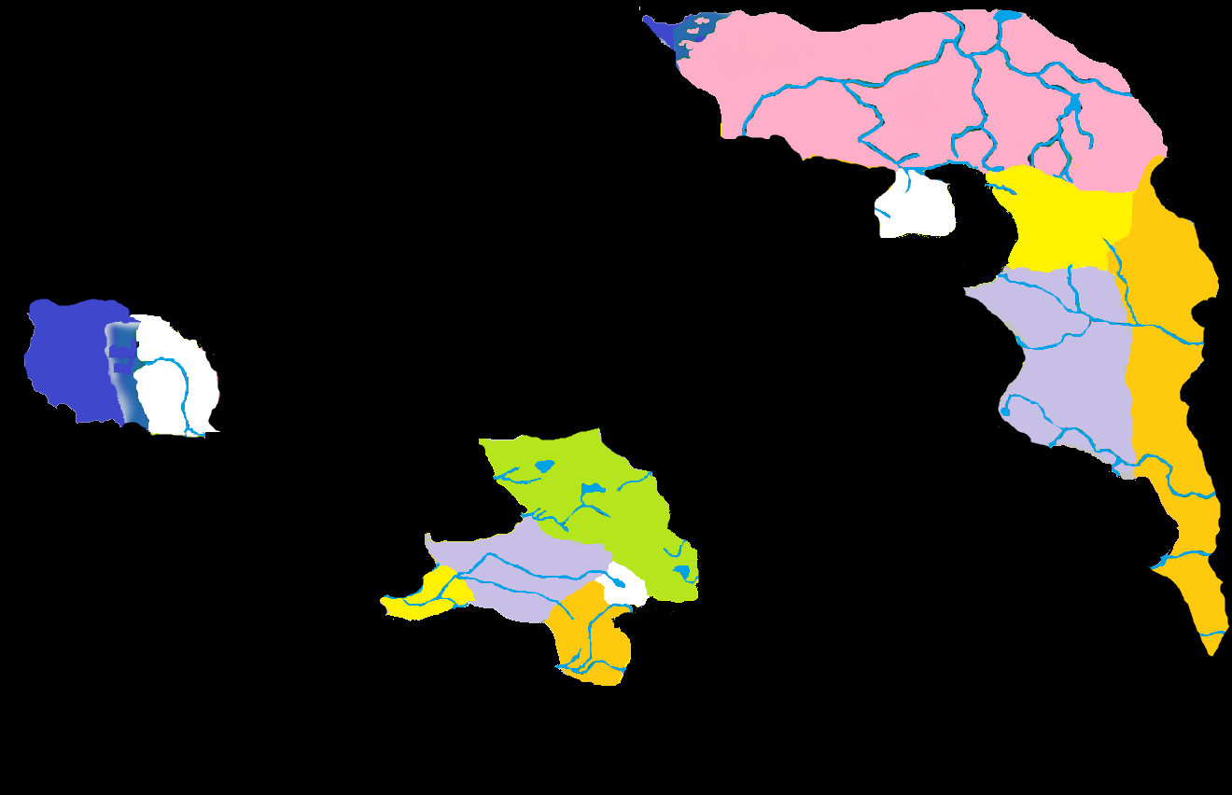
683 BC: Living Nightmare
Notes:
The bizarre Nightmare Lands created an alternate route between Darkon and Nova Vaasa, though only the maddest traveler would attempt to use it. An interesting anomaly of this timeline is that the Nightmare Lands were essentially the problem of Darkon and the Vaasi. Barovians or Mordentmen may not have even known of its existence until many years later. This is not to say that the Court did not reach into the dreams of these peoples, but the idea of an entire land that reflected the nightmares of dreamers would have probably been dismissed as traveler’s gossip.

Slide 14
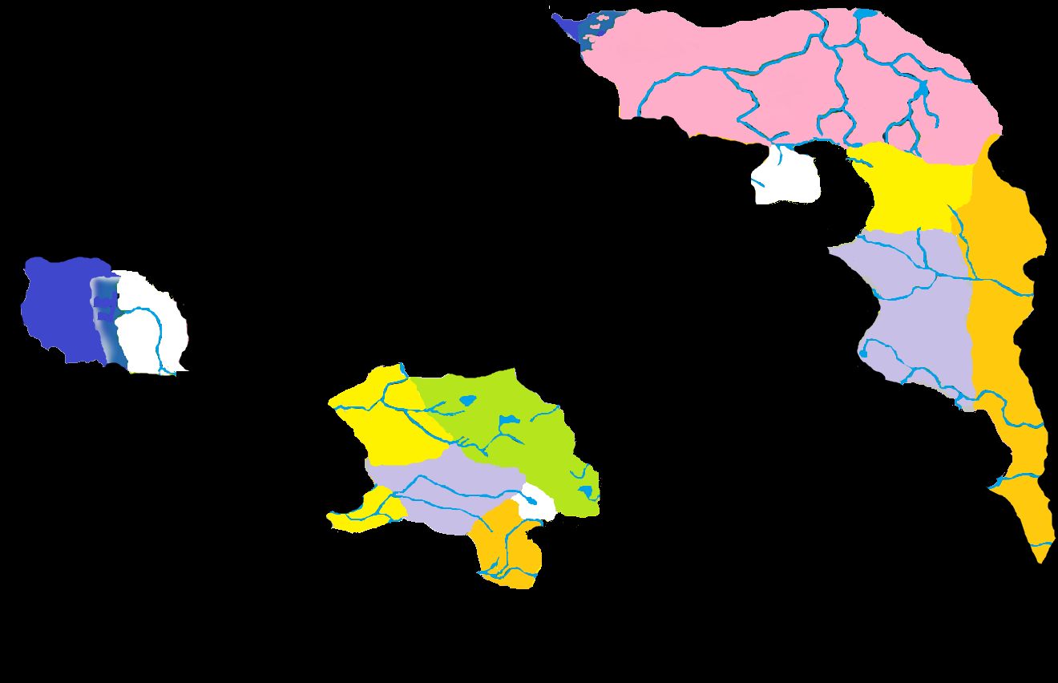
684 BC: Camille Cleans House
Notes:
When Camille Boritsi poisoned her husband and the majority of his family due to a thorn in her pride, she opened a portal long thought forgotten and joined her land of Borca with her sister nation of Barovia. The amount of civilization that arrived with her probably shook the cluster, and Levkarest could be considered a major cultural and commercial hub of the time. The Boritsi Trading Company probably conducted business under the best possible circumstances: without competitors.

Slide 15
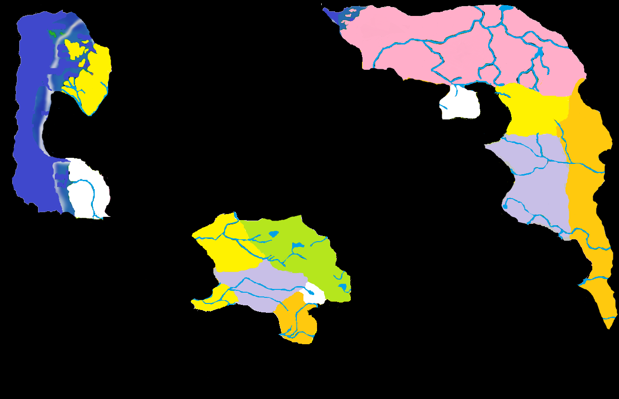
685 BC: The Good Doctor
Notes:
The Mordentish Cluster received its first major addition in 685 with the appearance of Lamordia. The pragmatic Lamordians and the industrious Mordentish were probably easy trade partners, although the superstitions of Mordent would have met brusque disdain in the north. While cordial to one another, Lamordia was isolationist to the point of not considering inclusion in any defense treaties that came up in the future.

Slide 16
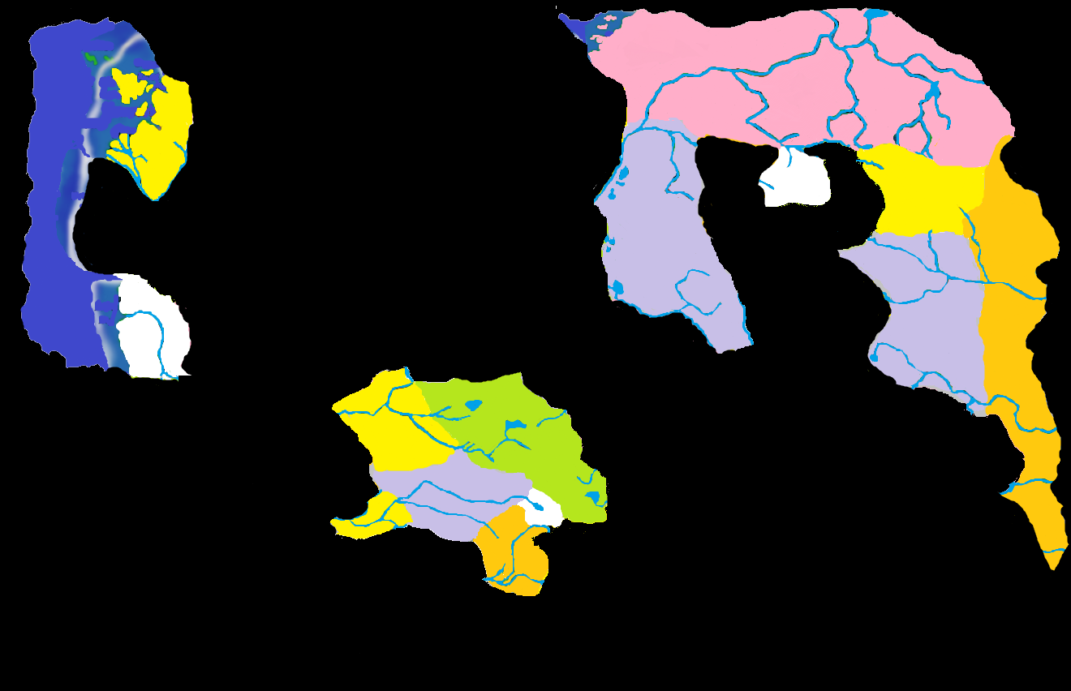
690 BC: A Threat to Darkon
Notes:
Vlad Drakov emerged from the Mists in Darkon, raised some hell, and was surprised when hell raised back. A year later, Drakov had a kingdom of his own, and the Dead Man Campaigns began in earnest against the only enemy he could reach. The Falkovnian grain industry was probably not as developed initially, and since they had made an enemy of their only neighbor, there was no one to trade with anyway. During this period, Falkovnians were probably felling trees and clearing forests for future use as farmland. It was probably more coincidence than design.

Slide 17

691 BC: Real Superstition
Notes:
The foundlings that would grow up to be the Mindefisk sisters were more than likely planted in Darkon by vengeful fey. When their domain of Tepest formed in 691, it created a more accessible trade route between Darkon and Nova Vaasa, while contributing little to that trade itself. Wedged between Keening and Arak, it is no wonder the fey were never far from Tepestani minds. That is probably how the fey liked it.

Slide 18
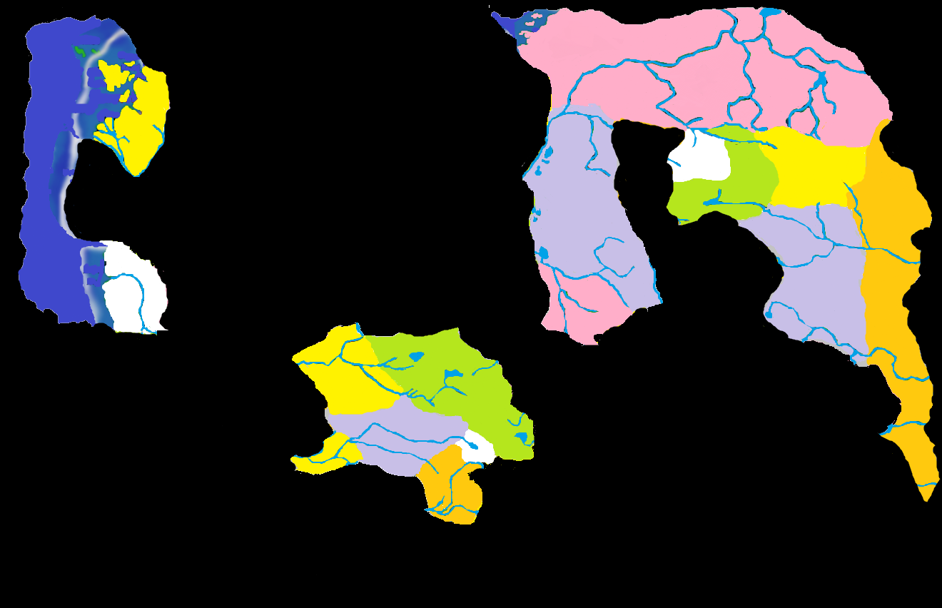
694: The Renier Exodus
Notes:
Drakov had to take a break from invading Darkon in order to attack a force within his own borders. How the Renier clan ended up in Falkovnia is not explained, but they were most certainly unwelcome. They fled south into the Mists and discovered the realm of Richemulot. Vast empty cities posed a tempting target for Drakov, but his scouts did not return from across the river, and he had already ground the majority of his military-aged population against Darkon in the previous years.

Slide 19
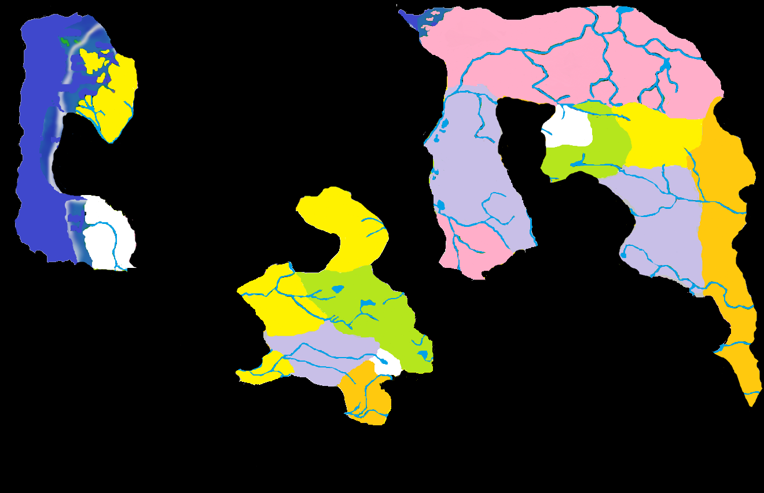
698 BC: Barovian Butcher
Notes:
Frantisek Markov had been using his butcher shop to cover up his experiments for years, but when the townsfolk discovered that they had been sold sausages made from Mrs. Markov, they chased the madman into the Mists. Aside from attracting intrepid mountain climbers, this new spur of the Balinoks probably held little interest to the people of the cluster. The strange creatures that occasionally wandered across the border most likely did not make it past the first pitchfork-wielding mob.

Slide 20
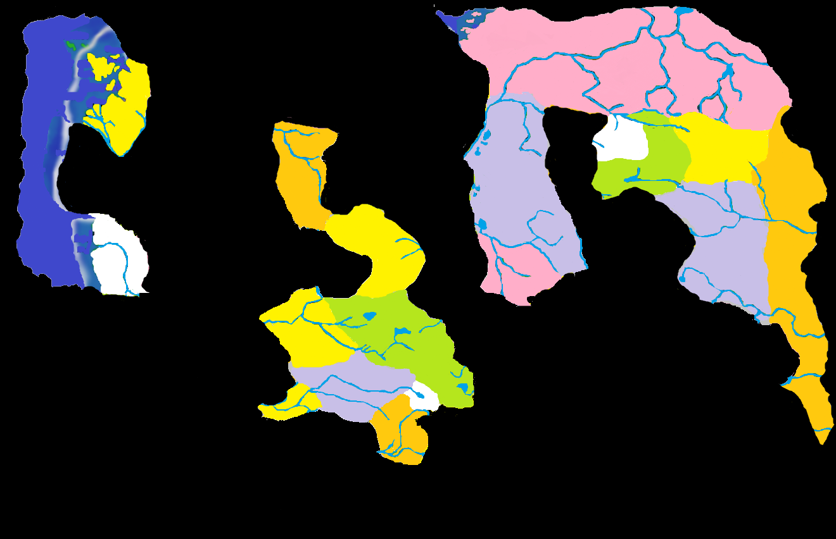
702 BC: Hail Zhakata!
Notes:
The Petrovna family had already fallen on hard times in the time since Barovia was drawn into the Mists, and with the appearance of Borca, their place in the history of the cluster was fully overshadowed. In the late 600s, the scions of the family were spoiled brutes that took more pleasure in bullying people than they did in leading them. The youngest, Yagno, was terrorized by his older brothers, and eventually withdrew into a fantasy world in which he served a powerful deity that only existed in his own mind. In 702, the adult Yagno took his imagined religion too far, and was cast out from society. Into the Mists he fled, and he was rewarded with a land that reflected his perverse imagination. G’Henna was a lonely bastion of the worship of Zhakata and the zealotous population enjoyed their isolation, leading them to believe their religion was the only one in existence.

Slide 21
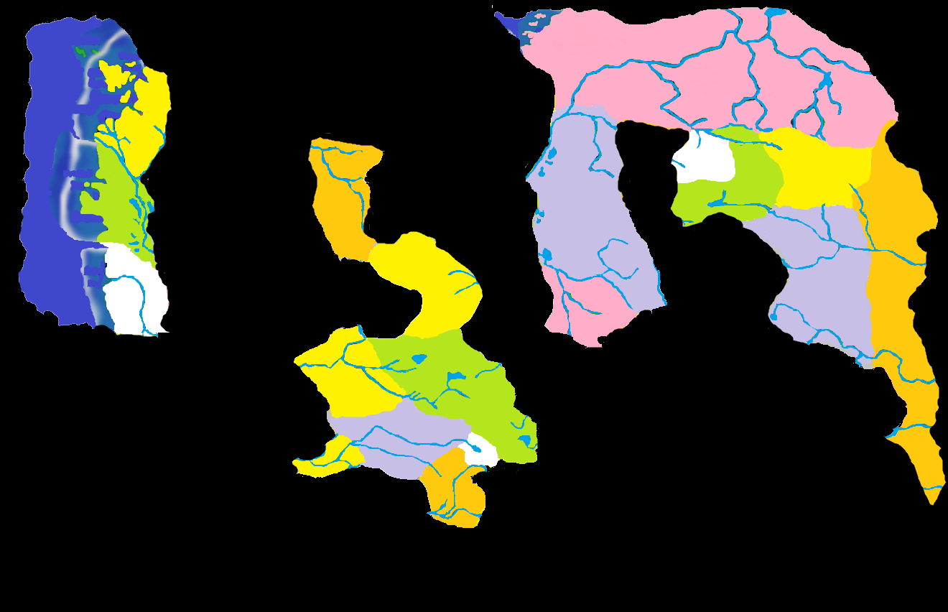
707 BC: Rediscovering Nobility
Notes:
Mordent had been cut off from the nobility that spawned it for over 125 years. In 707, a kindred nation appeared on Mordent’s northern border that slightly mimicked the old country from which Mordent had sprung. Speaking a dialect of the same language, Mordent and Dementlieu were fast allies, even if the newer nation considered the elder to be a rustic backwater. The shipping on the Sea of Sorrows became even more lively. Lamorida was cordial enough with its new neighbor, though still preferred to keep to itself in most matters. Dementlieu’s culture was certainly a beacon, but it had not yet found a large audience.

Slide 22
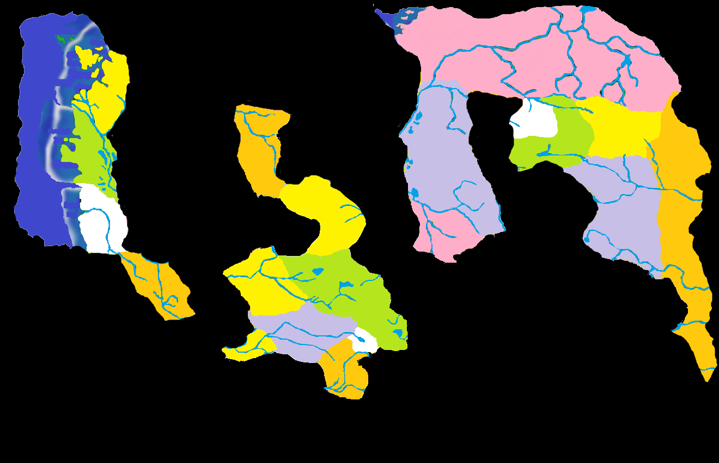
708 BC: Captain Timothy Goes Boating
Notes:
Nathan Timothy had been jealous of the Vistani’s ability to travel through the Mists and believed the sleepy Arden River was his ticket to other lands. He was partially correct, although the dangerous forest he discovered (and was trapped in) was not exactly the glimmering port he had in mind. Arkendale had only a tiny human population, and became something of a haven for those who had worn out their welcome in the more polite nations of the cluster. It became a favorite hunting ground for brash Dementliuese nobles, although before long, word got back that the nobles themselves were being hunted as often as not.

Slide 23
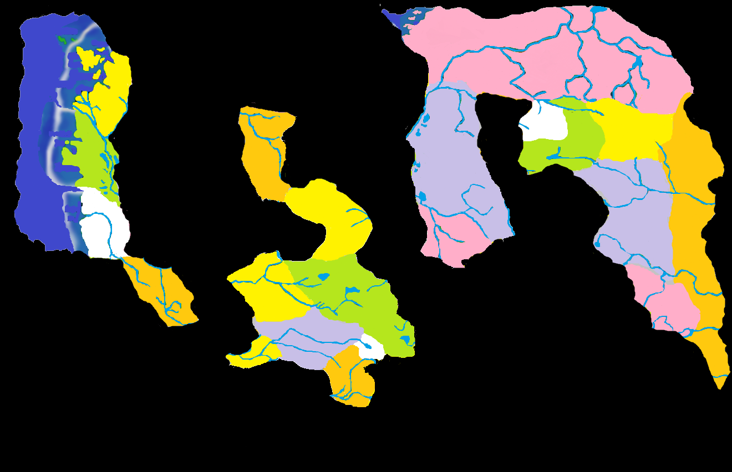
714 BC: The Red Wizard
Notes:
Shamed in his homeland of Thay, the bitter revenge-minded wizard, Hazlik, had become trapped in the Nightmare Lands where his dreams of vengeance had taken a terrifying turn and became real. Hazlik eventually fought off these shades and emerged in a land that resembled Thay, although here he was the supreme power. Although he disliked them, Hazlik held audiences with Vaasi nobles and promised them magical aid if they were ever invaded. This was something of an empty promise, since the Red Wizard had already discovered that he could not leave Hazlan.

Slide 24
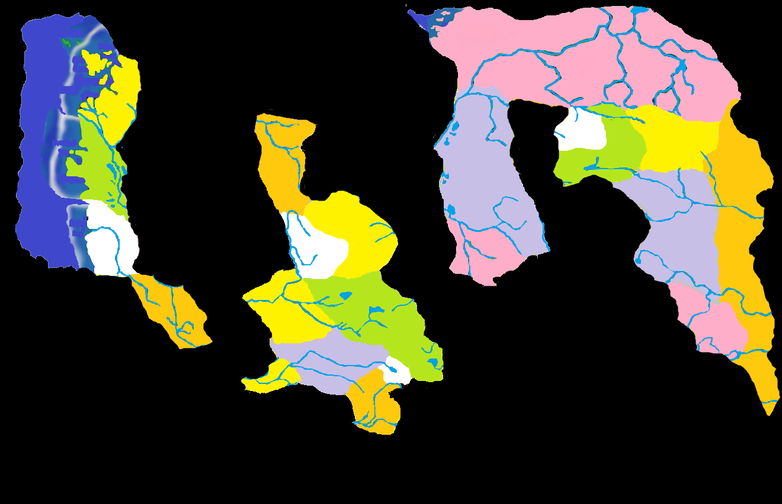
715 BC: Dilisnyas Live!
Notes:
The final addition to the Barovian Cluster was Dorvinia, a homeland for Strahd’s old enemies, the Dilisnya family. Dorvinians and Borcans were indistinguishable from each other. Both labored under the hefty taxes of opulent nobles, and both were eager to find way to circumvent these taxes. The Dorvinians developed a reputation for getting things done “without noble notice” although this organized crime ring was actually just another arm of Ivan’s secret police, and their profits filled his coffers regardless. The mercurial Ivan Dilisnya oscillated his dealings with his more rustic neighbors between colonization of Markovia and even outright war with G’Henna, though these ventures seldom held his interest for very long.

Slide 25
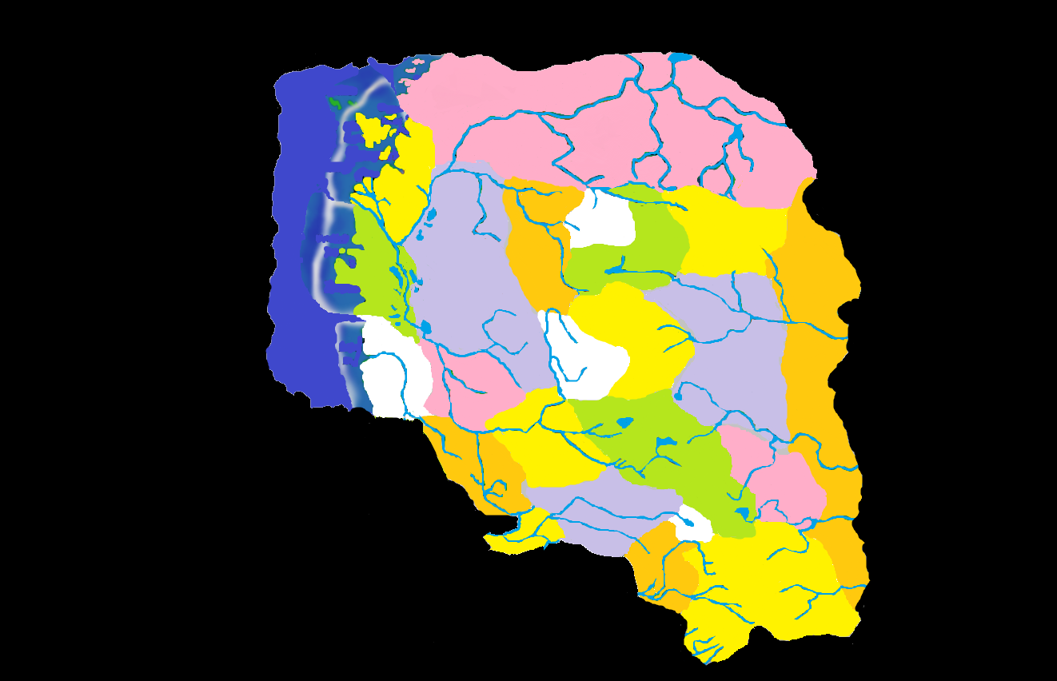
719 BC: The Core Congeals
Notes:
Sometime between 715 and 720 BC, the three main clusters reformed into a single landmass. The reasons for this are unclear, and any number of explanations are possible. The Illithids of Bluetspur may have been involved, and their domain (or at least a sliver of it) manifested itself in the southeast corner of what was now referred to as “The Core.” After so much isolation, the sudden increase in neighboring nations would have sent shockwaves through the economies and lives of the demiplane’s residents. Drakov could hardly decide who to invade first! Members of the original clusters tended to trust each other more than their new neighbors, but this was more of a guideline than a rule. Richemulot became something of a lynchpin to the new situation, as the only nation that shared borders with nations from each of the original clusters.

Slide 26
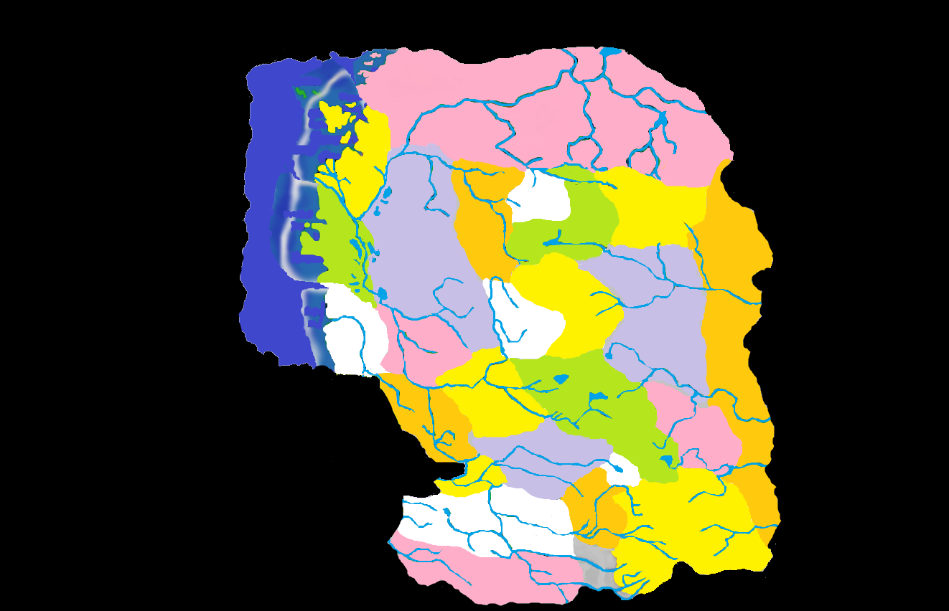
720 BC: Black Rose, Black Cat
Notes:
Lord Soth’s early actions in the demiplane are well documented. In canon timelines, his nation of Sithicus is the only one mentioned to have “joined the Core” and this fact lead to many of the assumptions of this particular timeline. When Sithicus formed, it brought Valachan with it, 95 years after the domain’s formation. This could set a precedent for other Islands of Terror joining the Core, as Vechor will after the Grand Conjunction. The Core may just be the first major landmass that forms as the Land of Mists continues to congeal.

Slide 27
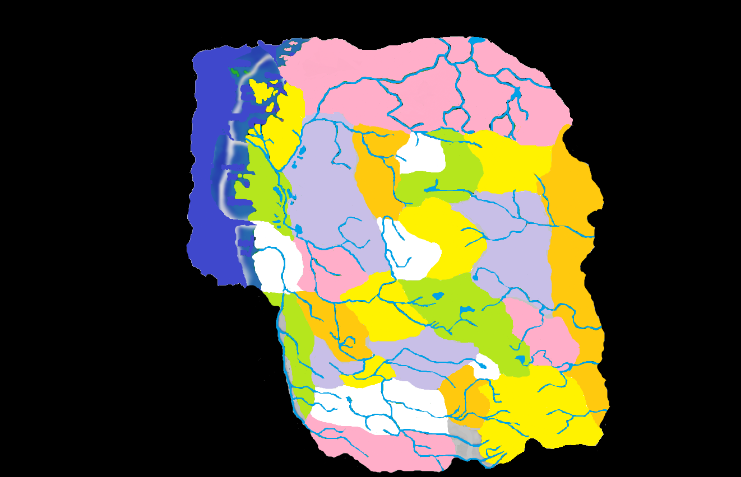
730 BC: Father’s Footsteps
Notes:
The final Core domain is Verbrek, discovered by Alfred Timothy on the border of his father’s realm of Arkendale. After the Grand Conjunction, Alfred will inherit his father’s domain as well. During this period, Bakholis is murdered by a young gypsy named Gabrielle Aderre, and Invidia falls to her rule. Claude Renier of Richemulot and Camille Boritsi of Borca have also been murdered and replaced, and this is essentially the state of things in 735 when the first campaigns in the Ravenloft setting begin.
The green sliver of land west of Verbrek and South of Mordent was not named, and has been omitted from many maps, but is included here for completeness. There is nothing to say that it arrived at the same time as Verbrek, but there is also nothing to say it did not.

Slide 28
THANKS
The Fraternity of Shadows, particularly David “Jester” Gibson, whose map was used as the basis for my work. Without that “stencil” I’d have never had the artistic talent to present this.
John W. Mangrum, whose Unofficial Ravenloft Timeline was invaluable in helping to keep dates straight.
Zak “Lord Cyclohexane” Gillman, whose Ideas are presented here with his permission.
This ends the 3rd Core Genesis Project.. It was originally developed by Lord Cyclohexane in the Fraternity of Shadows forum, although the commentary for each slide was written by Strahdsbuddy. These alternate projects have been presented with the intent of spurring conversation, and are not meant to replace canon or change the way games are run.
Matt “Strahdsbuddy” Doyle, 2011
Insert Legal Disclaimer Here

